Slide 1

MANAGEMENT

Slide 2
Session objectives
🞂​ Explain quality in software project management
🞂​ Explain project quality management processes
🞂​ Describe tools and techniques
🞂​ Explain types of project quality costs

Slide 3
What Is Project Quality Management?
🞂​ The International Organization for Standardization (ISO) defines quality as the total characteristics of an entity that bear on its ability to satisfy stated or implied needs
🞂​ Other experts define quality based on
Conformance to requirements: meeting written specifications
Fitness for use: ensuring a product can be used as it was intended.

Slide 4
Project Quality Management Processes
Quality planning: identifying which quality standards are relevant to the project and how to satisfy them
Quality assurance: evaluating overall project performance to ensure the project will satisfy the relevant quality standards
Quality control: monitoring specific project results to ensure that they comply with the relevant quality standards while identifying ways to improve overall quality

Slide 5
Modern Quality Management
🞂​Modern quality management
🞂​requires customer satisfaction
🞂​prefers prevention to inspection
🞂​recognizes management responsibility for quality

Slide 6
Quality Planning
🞂​ It is important to design in quality and communicate important factors that directly contribute to meeting the customer’s requirements
🞂​ Design of experiments helps identify which variables have the most influence on the overall outcome of a process
🞂​ Many scope aspects of software projects affect quality like functionality, features, system outputs, performance, reliability, and maintainability

Slide 7
Quality Assurance
🞂​ Quality assurance includes all the activities related to satisfying the relevant quality standards for a project
🞂​ Another goal of quality assurance is continuous quality improvement
🞂​ Benchmarking can be used to generate ideas for quality improvements
🞂​ Quality audits help identify lessons learned that can improve performance on current or future projects

Slide 8
Quality Control
🞂​The main outputs of quality control are
🞂​ Acceptance decisions
🞂​ Rework
🞂​ Process adjustments
🞂​Some tools and techniques include
🞂​ Pareto analysis
🞂​ Statistical sampling
🞂​ Quality control charts
🞂​ Testing

Slide 9
Pareto Analysis
🞂​Pareto analysis involves identifying the vital few contributors that account for the most quality problems in a system
🞂​Also called the 80-20 rule, meaning that 80% of problems are often due to 20% of the causes
🞂​Pareto diagrams are histograms that help identify and prioritize problem areas

Slide 10

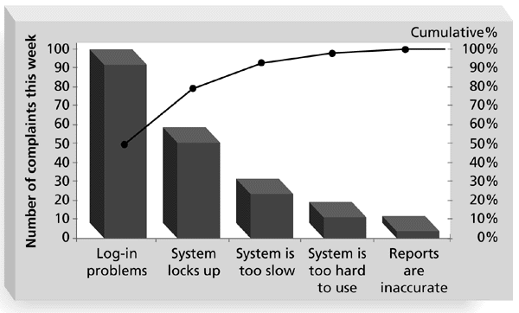
Sample Pareto Diagram

Slide 11
Statistical Sampling and Standard Deviation
🞂​Statistical sampling involves choosing part of a population of interest for inspection
🞂​The size of a sample depends on how representative you want the sample to be
🞂​Sample size formula:
Sample size = 0.25 × (certainty Factor/acceptable error)²

Slide 12
Commonly Used Certainty Factors
Confidence Level | Certainty Factor
95% | 1.960
90% | 1.645
80% | 1.281

Slide 13
Standard Deviation
🞂​ Standard deviation measures how much variation exists in a distribution of data
🞂​ A small standard deviation means that data cluster closely around the middle of a distribution and there is little variability among the data
🞂​ A normal distribution is a bell-shaped curve that is symmetrical about the mean or average value of a population

Slide 14

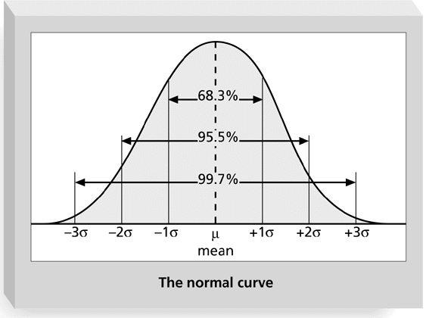
Normal Distribution and Standard Deviation

Slide 15
Sigma and Defective Units
Specification Range (in +/- Sigmas) | Percent of Population Within Range | Defective Units Per Billion
1 | 68.27 | 317,300,000
2 | 95.45 | 45,400,000
3 | 99.73 | 2,700,000
4 | 99.9937 | 63,000
5 | 99.999943 | 57
6 | 99.9999998 | 2
Note: “Six sigma” often refers to +/-3 sigma, meaning 2.7 million defects per billion units produced, or 2.7 defects per million.

Slide 16
Quality Control Charts, Six Sigma, and the Seven Run Rule
🞂​ A control chart is a graphic display of data that illustrates the results of a process over time. It helps prevent defects and allows you to determine whether a process is in control or out of control
🞂​ Operating at a higher sigma value, like 6 sigma, means the product tolerance or control limits have less variability
🞂​ The seven run rule states that if seven data points in a row are all below the mean, above the mean, or increasing or decreasing, then the process needs to be examined for non-random problems

Slide 17

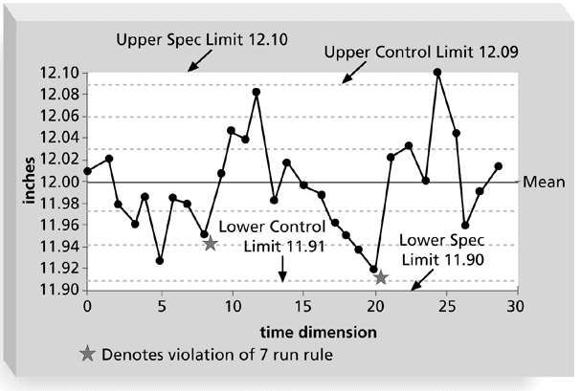
Sample Quality Control Chart

Slide 18

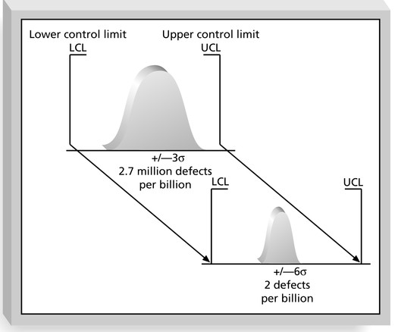
Reducing Defects with Six Sigma

Slide 19
Testing
🞂​Many SW professionals think of testing as a stage that comes near the end of SW product development
🞂​ Testing should be done during almost every phase of the SW product development life cycle

Slide 20

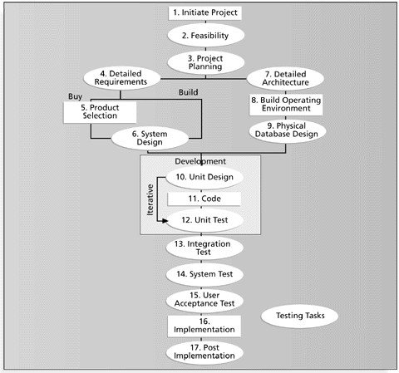
Testing tasks in the software development life cycle

Slide 21
Types of Tests
🞂​ Unit testing is done to test each individual component (often a program) to ensure it is as defect free as possible
🞂​ Integration testing occurs between unit and system testing to test functionally grouped components
🞂​ System testing tests the entire system as one entity
🞂​ User acceptance testing is an independent test performed by the end user prior to accepting the delivered system

Slide 22

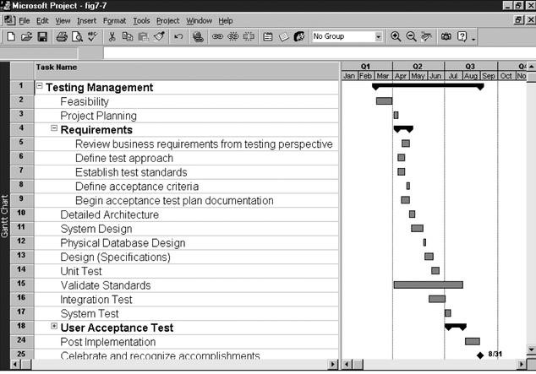
Gantt Chart for Building Testing into a Systems Development Project Plan

Slide 23
Improving Software Project Quality
🞂​Several suggestions for improving quality for Software projects include:
🞂​ Leadership that promotes quality
🞂​ Understanding the cost of quality
🞂​ Focusing on organizational influences and workplace factors that affect quality
🞂​ Following maturity models to improve quality

Slide 24
Leadership
“It is most important that top management be quality-minded. In the absence of sincere manifestation of interest at the top, little will happen below.” (Juran, 1945)
A large percentage of quality problems are associated with management, not technical issues

Slide 25
The Cost of Quality
🞂​The cost of quality is
🞂​ the cost of conformance or delivering products that meet requirements and fitness for use.
🞂​ the cost of nonconformance or taking responsibility for failures or not meeting quality expectations.

Slide 26
Cost Categories Related to Quality
🞂​The Cost of Quality category codes are the following:
Prevention Costs
Appraisal Costs
Internal Error Costs
External Error Costs
Measurement and test equipment costs

Slide 27
1. Prevention Costs
🞂​Prevention costs are investments made ahead of time in an effort to ensure conformance to requirements.
🞂​Examples include activities such as orientation of team members, training, and the development of project standards and procedures.

Slide 28
2. Appraisal Costs
🞂​Appraisal costs are costs incurred to identify defects after the fact.
🞂​Examples include activities such as walk- throughs and testing.

Slide 29
3. Internal Error Costs
🞂​Internal error costs are the costs of rework and repair before delivery to a customer.
🞂​An example is fixing faults detected during internal testing.

Slide 30
4. External Error Costs
🞂​External error costs are the costs of rework and repair after delivery to a customer.
🞂​One example would be rework and repair resulting from acceptance testing.
🞂​Another example would be the actual costs incurred during warranty support.

Slide 31
Measurement and Test Equipment Costs
🞂​Measurement and test equipment costs include capital cost of equipment used to perform prevention and appraisal activities

Slide 32
ISO 9000
🞂​ An international set of standards for quality management.
🞂​ Applicable to a range of organisations from manufacturing to service industries.
🞂​ ISO 9001 applicable to organisations which design, develop and maintain products.
🞂​ ISO 9001 is a generic model of the quality process that must be instantiated for each organisation using the standard.

Slide 33
ISO 9000 certification
🞂​Quality standards and procedures should be documented in an organisational quality manual.
🞂​An external body may certify that an organisation’s quality manual conforms to ISO 9000 standards.
🞂​Some customers require suppliers to be ISO 9000 certified although the need for flexibility here is increasingly recognised.

Slide 34
Software quality attributes
Safety | Understandability | Portability
Security | Testability | Usability
Reliability | Adaptability | Reusability
Resilience | Modularity | Efficiency
Robustness | Complexity | Learnability

Slide 35

Many thanks

